Slide 1
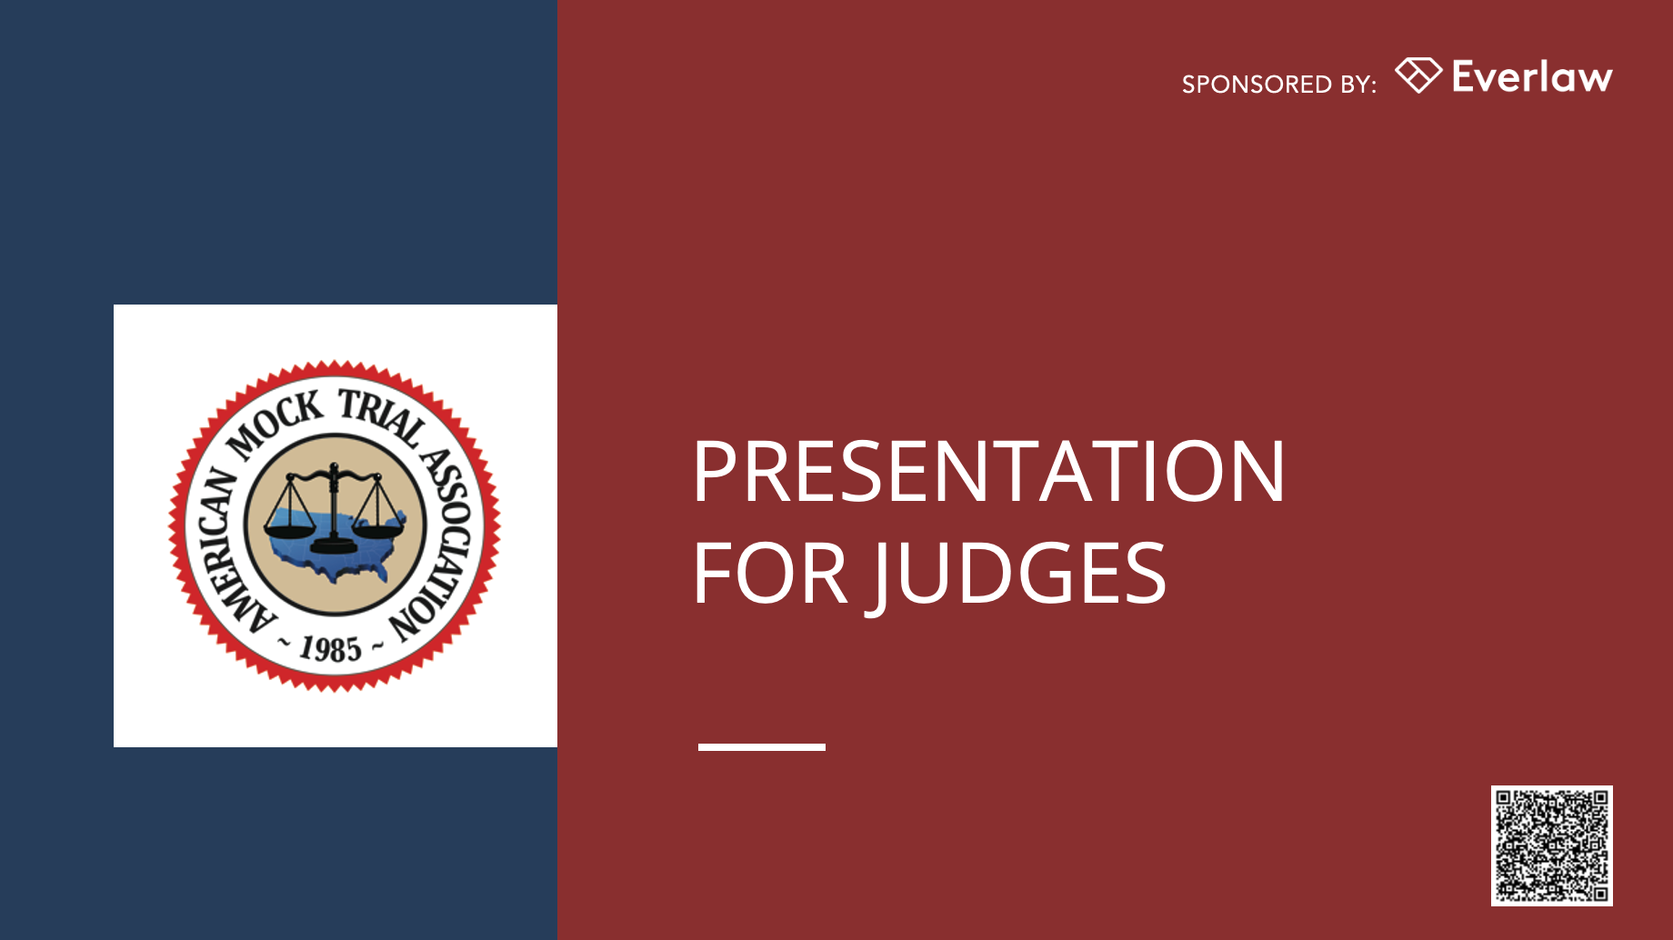


Slide 2
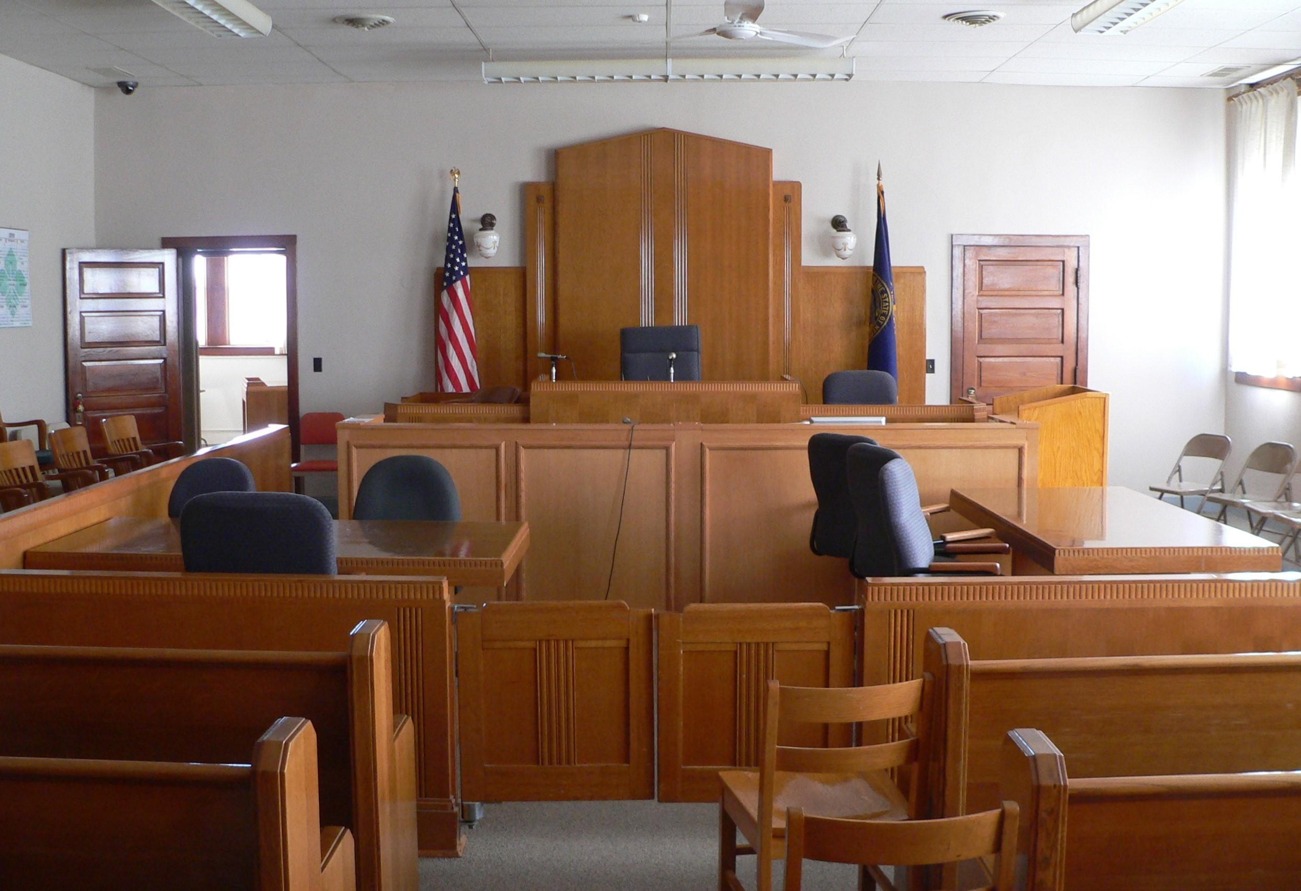
AGENDA
Trial Structure
Scoring, Presiding, & Commenting
Timekeeping & Other Rules

Slide 3
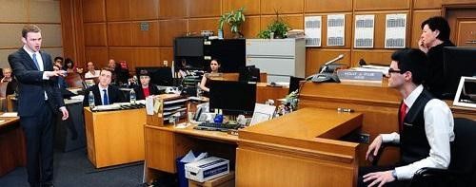
What is mock trial?
Mock trial is a simulation of a jury trial where students portray attorneys and witnesses. The trial happens in the fictional jurisdiction of Midlands, which has its own:
Case Law
Statutes
Rules of Evidence (similar to FRE)

Slide 4

The Estate of Ali Alekri et al v. Midlands Gas & Electric
2026-27 Civil Case
On January 1, 2026, following a late-night car crash into a roadside utility pole, a wildfire spread through the Rapid River Valley area, resulting in millions of dollars of property damage and 12 deaths. The families of the victims brought civil negligence actions against Midlands Gas and Electric (“MG&E”), the utility company responsible for maintaining the infrastructure in the area. The court has consolidated the various actions into a single lawsuit to determine whether MG&E’s actions and inactions caused the wildfire.

Slide 5
Case Information
Complaint. The Plaintiff may pursue different theories of negligence.
Defense. The Defense may elect to contest the charge and/or pursue an affirmative defense. Pursuing an affirmative defense does not alleviate the Plaintiff of its burden.
All Constitutional objections overruled. All potential constitutional issues that might normally be addressed through pretrial motion have been raised and overruled.

Slide 6
TRIAL COMPONENTS
Pre-trial Matters / Introductions
Opening Statements
Plaintiff / Prosecution Case-in-Chief
Customary Break
Defense Case-in-Chief
Customary Break
Closing Arguments / Rebuttal

Slide 7

PRESIDING, SCORING, & COMMENTING
How to evaluate the round

Slide 8
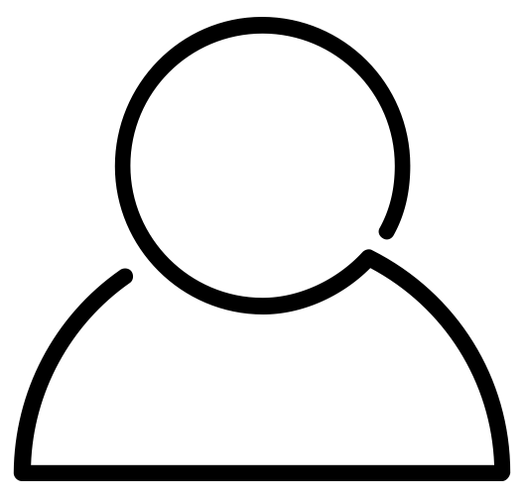
Your Role
You are here to judge the trials and evaluate the students’ performances
You will do so in panels of two or more individuals
PRESIDER
SCORER(S)
Score
(if needed)
Provide feedback
Preside
(rule on objections, keep trial moving)
Score
Provide feedback

Slide 9
PRESIDER: RULING ON OBJECTIONS
In general, please allow students to be heard on objections. We want them to display what they do (and don’t) know.
Try not to let objection arguments drag on too long. Allowing each advocate to speak one or two times should be sufficient for ruling on most objections.
Please do not raise your own objections and do not question the witnesses yourself.
You have discretion and final say in your rulings.

Slide 10
Unique Aspects of Trials in Midlands
  NO objections to openings or closings
  Defense MUST open after prosecution opens (no deferred openings)
  NO argued motions in limine, for a directed verdict, or mistrial
  NO side bars
  NO scope limitations on cross-examination (but scope is limited on re-direct and re-cross examination)
  All witnesses MUST be cross examined
  NO tendering of expert witnesses
  NO binding law or precedents, other than those provided in Midlands statutes and the case law included in the case packet
  NO Constitutional objections
Differences from real-world trials

Slide 11
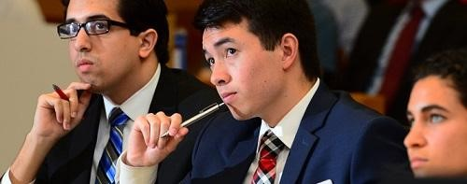
Movement Throughout Trial and Exhibits
While other jurisdictions may differ, please allow students to move throughout the well and use demonstrative aids (subject to objections).
Students may elect to provide exhibits to the Court and witnesses via exhibit binders they have provided, which may be located at the bench and witness stand.

Slide 12
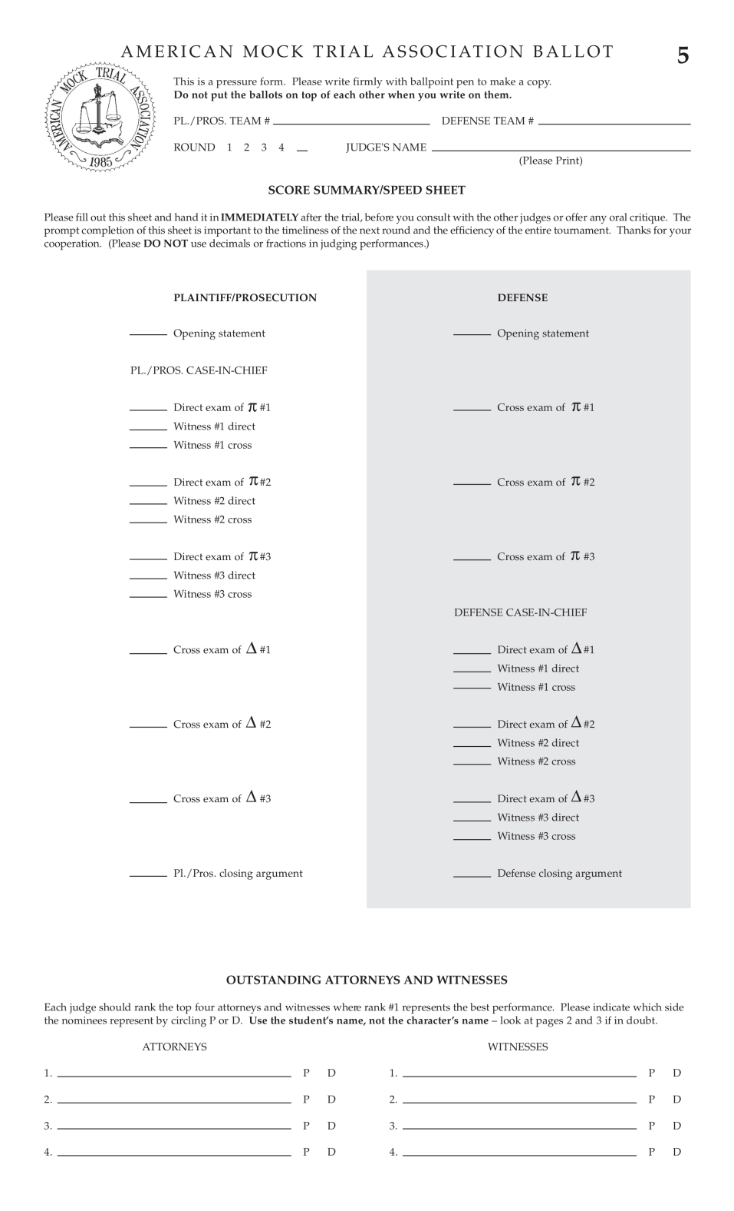
The Ballot
Ballot has 3 carbon copy pages
Don’t write on the full stack!
Be sure to set each page directly on the table to write

Slide 13
Ballot Organization
Plaintiff / Prosecution (π)
LEFT
Plaintiff / Prosecution
RIGHT
Defense
Defense scores are shaded
Defense (Δ)

Slide 14
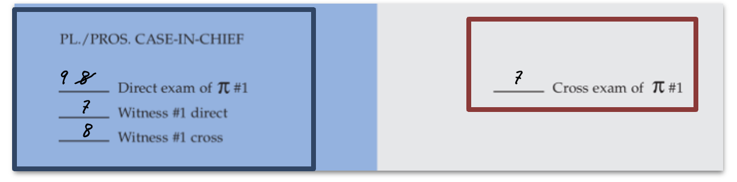
Using the Ballot
After each witness has finished, you should have four scores filled out:
-Directing attorney
-Witness on direct
-Witness on cross
-Crossing attorney
Plaintiff/
Prosecution
Defense
Editing: If you need to change a score, cross it off and re-write the modified score next to it clearly

Slide 15
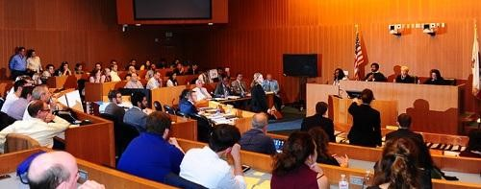
Remember: Witnesses are scored twice – on Direct AND Cross!

Slide 16
No Separate Scores For:
Pre-trial matters
Re-direct examinations
Re-cross examinations
Rebuttal
Objections
Instead, you can consider these in the corresponding scored portion (for example, the rebuttal may influence your score for closing).

Slide 17
Score as you go & write scores on
the ballot!

Slide 18
You’re not reaching a verdict.
Score on your own (don’t confer with co-judge on scores).

Slide 19
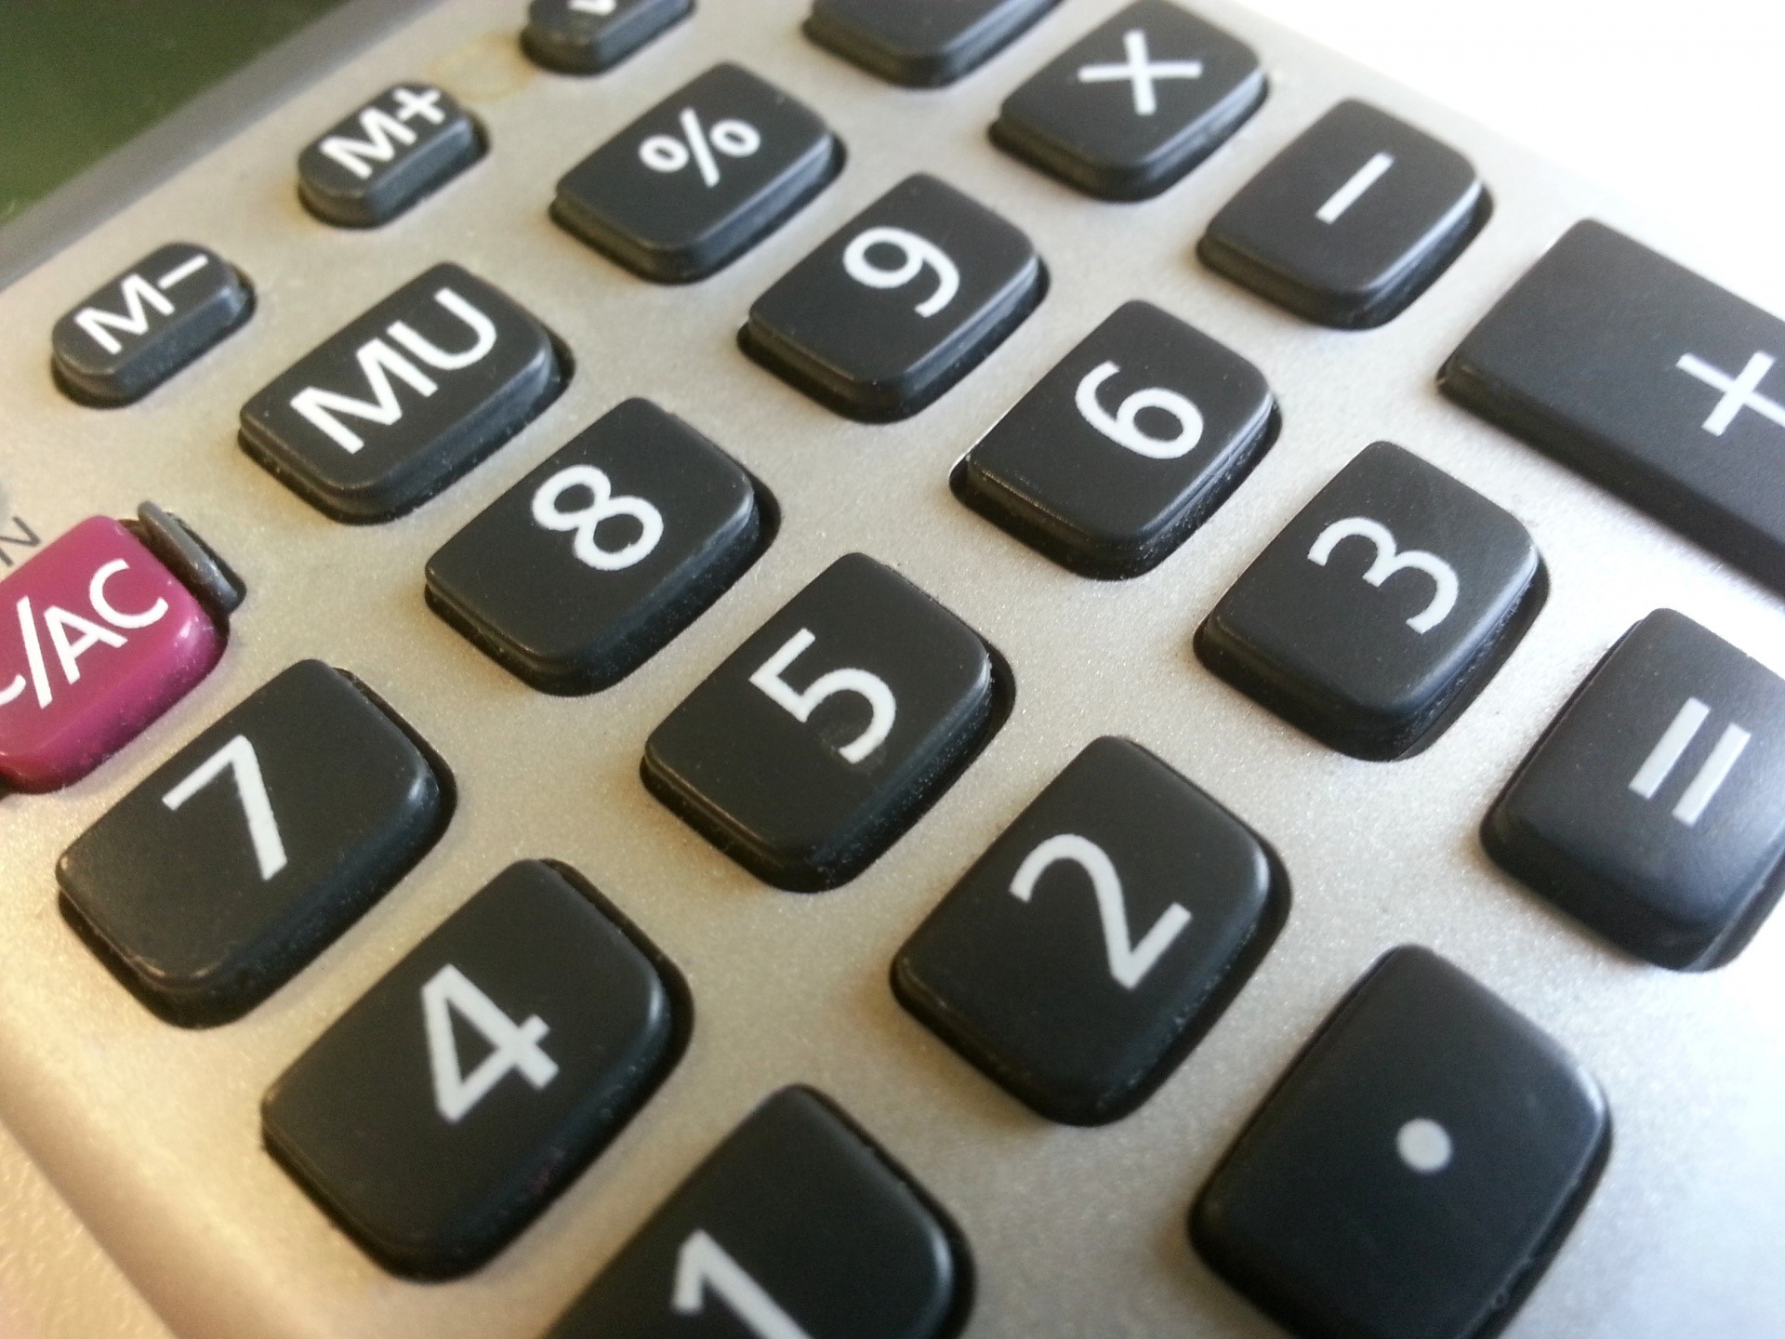
Scoring Framework
RANGE
Score from 1-10, with 10 being the best score
No decimals, only whole numbers
No zeros*
* Unless the role didn’t occur
DIFFERENTIATE
Use scores to differentiate performances
Scale doesn’t matter, just be internally consistent

Slide 20
Scoring Framework
What TO Consider
Presentation / poise
Knowledge of the facts / rules of evidence
Ability to present a case on direct / control witnesses on cross
Witness credibility and character
What NOT to Consider
What you saw in prior trials
Which side would win in a real trial (merits)
Student health precautions (like masks)
Attire of attorneys or witnesses*
*Witnesses are allowed to wear costumes, but are not required to do so

Slide 21
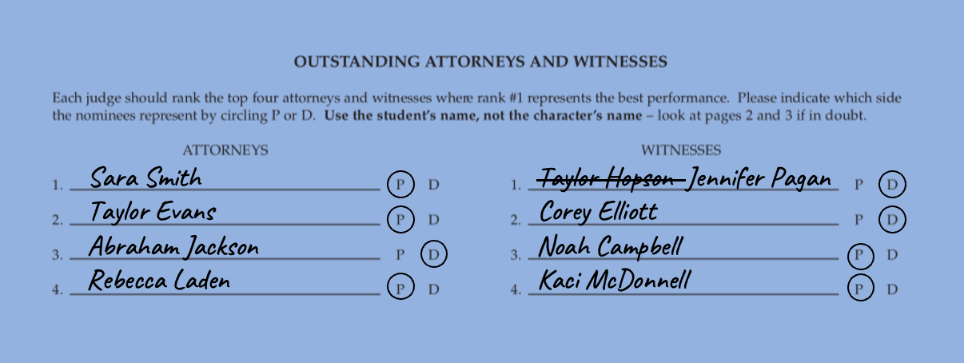
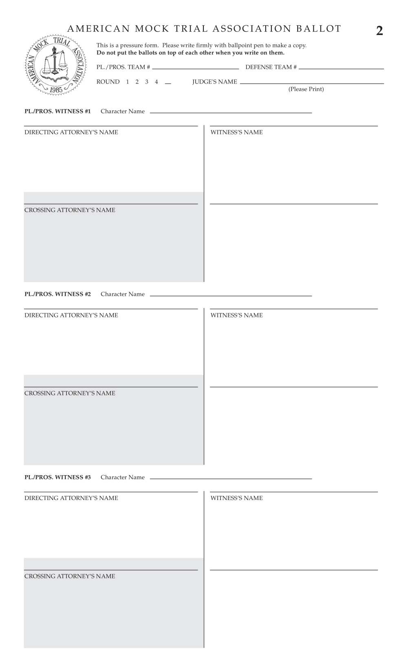
Individual Awards
Write the WITNESS NAME name, not the CHARACTER NAME
Circle P or D
Must fill out all four slots

Slide 22
Scoring Consistency and Student Experience
Please apply criteria for excellence consistently across all competitors, focusing on performance quality and competency.
Please do not consider students’ race, gender, age, sexual orientation, or other similar factors when scoring.
Please help us make this activity a warm, welcoming and educational experience for all students. Feedback should, where appropriate, be encouraging, and should focus on areas that students can improve in future rounds.

Slide 23
Invention of Fact
All Witnesses
  Limited to sworn affidavits and reports (and materials relied upon) and reasonable inferences on direct examination.
  On cross examination, must not contradict their affidavit….
  …but if an attorney asks a question outside of the affidavit, then the attorney is stuck with the answer.

Slide 24
Invention of Fact
In Trial Remedies
This competition has NO “invention of fact” objection when teams believe that a witness has improperly invented facts.
Instead, the rules allow students to attempt to impeach the witness during cross examination (via contradiction or omission).
Each scoring judge determines whether testimony offered by a witness is a reasonable inference or an invention of fact. If you believe the impeachment was effective in showing there was an invention of fact, then score accordingly on your blue ballot.

Slide 25

PROVIDING COMMENTS

Slide 26
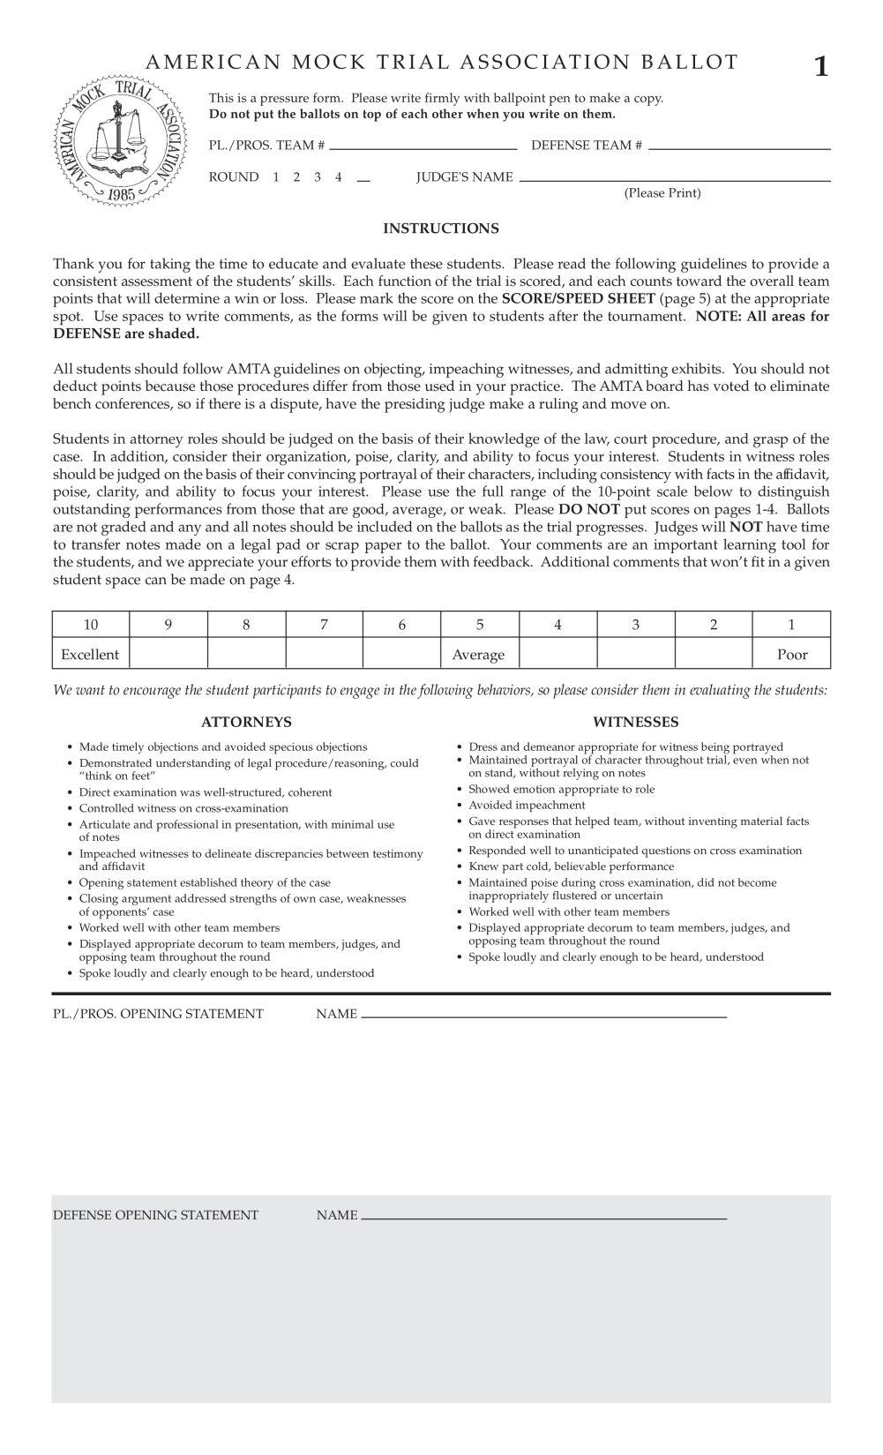
Giving Comments
All scoring judges should receive four comment sheets (also carbonless copy paper, so don’t write on the full stack!)
Students fill out their names / roles / team code

Slide 27
Giving Comments
Plaintiff / Prosecution
Use blank spaces to write comments
Non-shaded refer to Plaintiff / Prosecution parts
Shaded is for Defense
Find student names for individual awards
Defense

Slide 28
Giving Comments
Students will receive copies of the written comments after the competition. Please write legibly.
After the trial is complete, please provide a few minutes of general verbal feedback

Slide 29
TIMEKEEPING & OTHER RULES

Slide 30
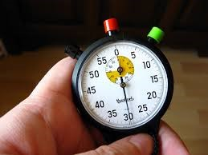
Timekeepers
Students act as timekeepers
The trial has a 3-hour time limit, and each part of the trial has specific time limits
Please enforce time limits when informed of them to avoid exceeding the “all-loss time”

Slide 31
Anonymity & Spectators
Students’ school identity should remain anonymous until after the round
All trials are public; don’t assume the identity of the teams based on who enters the courtroom

Slide 32
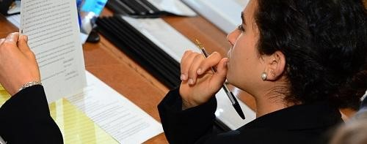
Conflicts
If you have already judged a team at this particular tournament, please DON’T start the trial; inform tournament staff
If you are affiliated with the team (e.g., your child is on the team), please DON’T start the trial; inform the event representative

Slide 33
What happens next?
Questions & Judging Assignments!

Slide 34

Thanks!

